Slide 1
Twitter US Airline Sentiment Analysis
By William Dew

Slide 2
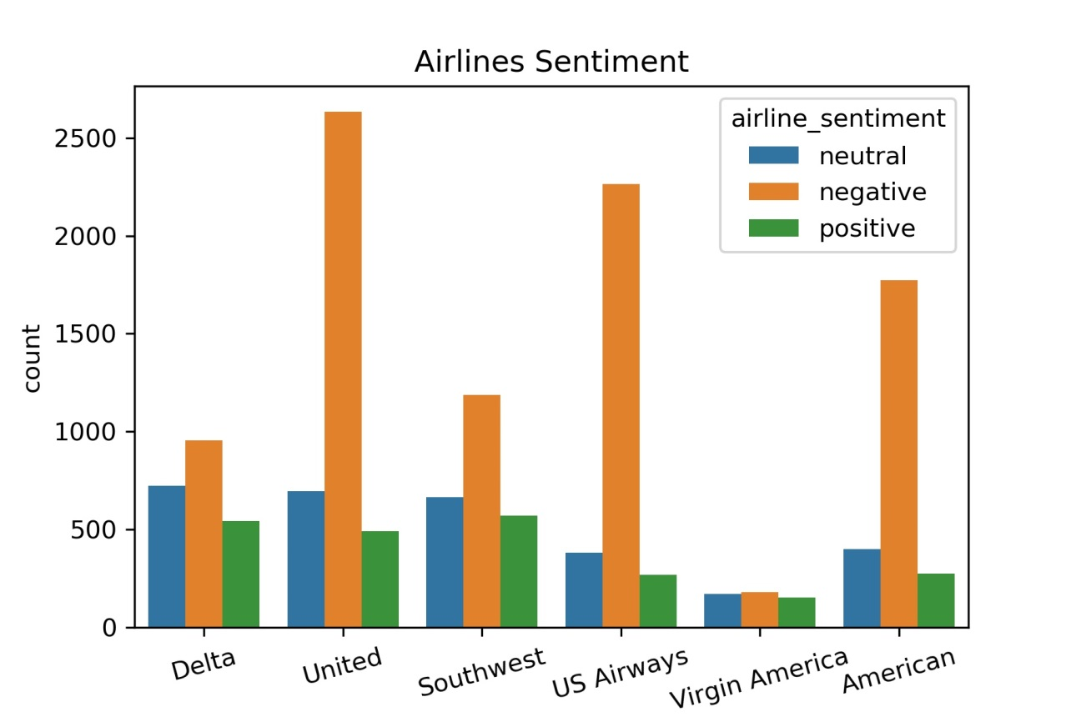
Data

Slide 3
Data Wrangling
Tweet cleaning steps
Convert text to lower-case
Remove URLs
Remove usernames
Remove punctuation
Remove stopwords

Slide 4
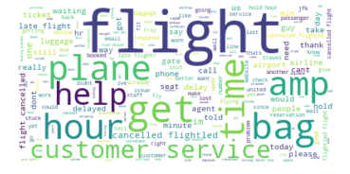
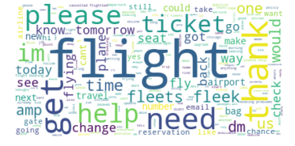
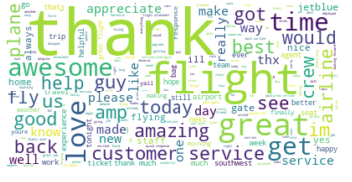
Word balloons
Negative
Neutral
Positive

Slide 5
models
Classifiers
Naïve Bayes
SVM
Random Forest
Cross Validation
Grid Search
Random Search
Vectorizers
Bag of Words
Tfidf
Data
Classifiers
Naïve Bayes
SVM
Random Forest
Cross Validation
Grid Search
Random Search

Slide 6
Cross validation
Vectorizer | Classifier | Training Set F1 | Validation Set F1
Bag of Words | Naïve Bayes | 0.969 (0.002) | 0.634 (0.009)
Bag of Words | SVM | 0.968 (0.001) | 0.707 (0.010)
Bag of Words | Random Forest | 0.991 (0.001) | 0.701 (0.012)
Tfidf | Naïve Bayes | 0.985 (0.001) | 0.639 (0.009)
Tfidf | SVM | 0.880 (0.001) | 0.695 (0.005)
Tfidf | Random Forest | 0.990 (0.001) | 0.698 (0.011)

Slide 7
Test Set Results
Vectorizer | Classifier | Precision | Recall | F1
Bag of Words | SVM | 0.731 | 0.699 | 0.713
Test Set F1 score (0.713) is higher than Train (0.707) and Validation (0.707) F1 scores
Precision and Recall given to show model performance

Slide 8
Further Inquiries
Explore URLs and usernames
Validate more hyper parameters for Bag of Words and Tfidf
Look into oversampling and downsampling data
Build model with non-text features

